Slide 1


Slide 2
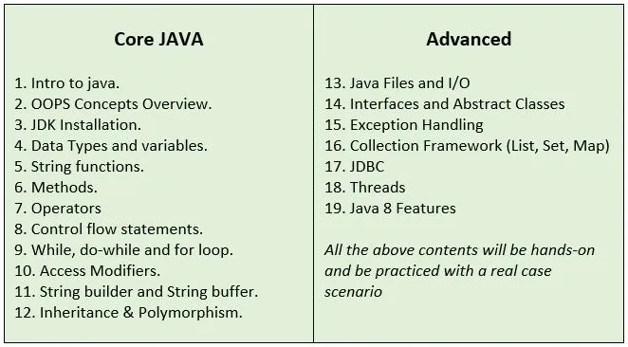
20. Swing Framework
21. Real Projects

Slide 3
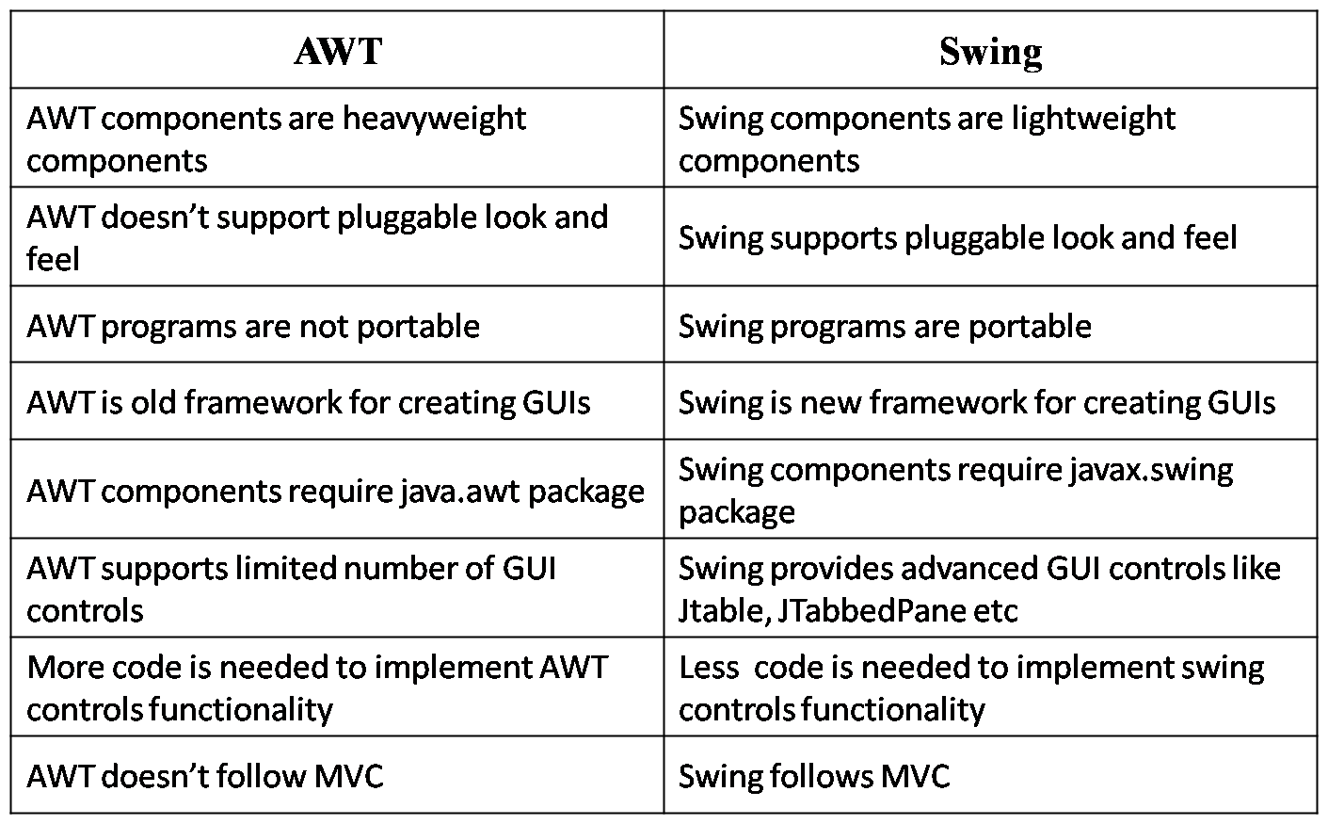

Slide 4
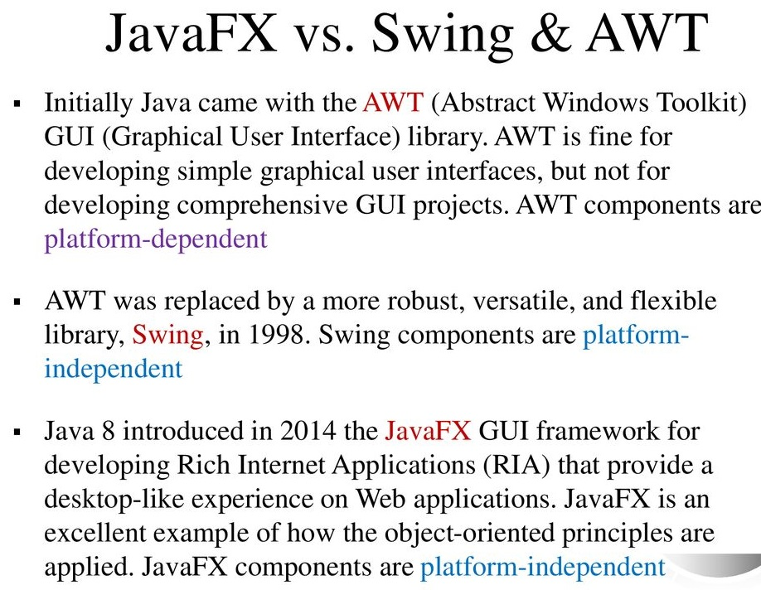
Swing Framework

Slide 5
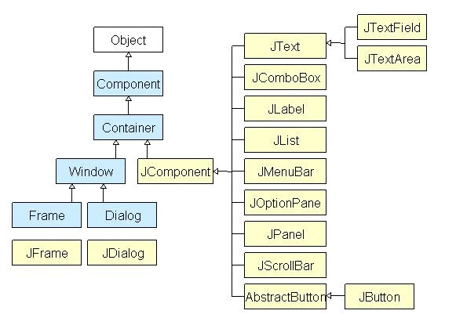
Swing Framework

Slide 6
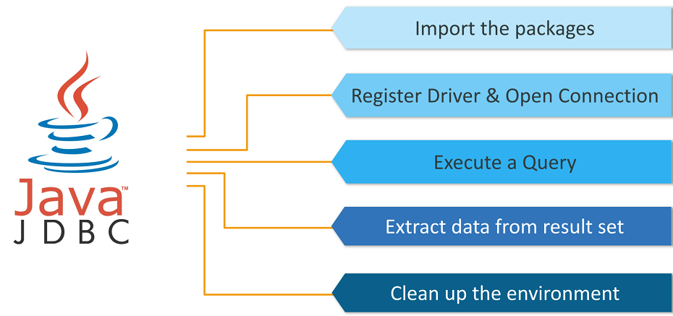

Slide 7
Swing Framework

Slide 8
Swing Framework

